Slide 1

Self Learning Robot: A robot that learns to follow motion command using Reinforcement Learning
Under Supervision of : Dr. Haider Banka
By : Yeshvendra Kumar Singh
INDIAN INSTITUTE OF TECHNOLOGY (INDIAN SCHOOL OF MINES), DHANBAD
Dated: 16th May, 2018

Slide 2
Introduction
Build a robot which could self learn to follow the motion command.
Learn what are the efficient combination of motors to move straight, left, right and back.
Irrespective of number of motors attached (i.e. irrespective of degree of freedom).
A robot that can be controlled using a remote.

Slide 3
Literature Survey
S.No. | Name of Paper | Author | Description
1. | Feudal Reinforcement Learning | Dayan, Peter, and Geoffrey E. Hinton | Use of Reinforcement Learning in a simple maze task.
2. | Learning to predict by the methods of temporal differences. | Richard S. Sutton | Advantages of temporal difference learning.
3. | Robotic control systems based on bio inspired multi-agent systems: application of the principles of neuroscience to robotics. | Berná-Martínez, José Vicente, and Francisco Maciá Pérez | Used the concept of neuroscience in robotics and suggested that application of services should be based on expected result.

Slide 4
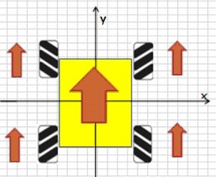
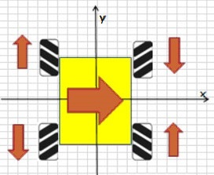
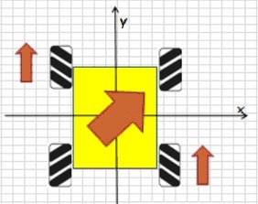
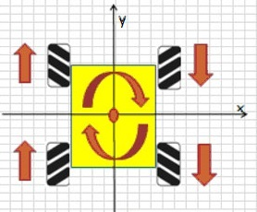
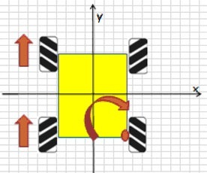
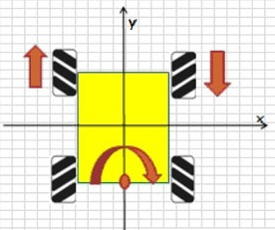
Problem Definition
If the degree of freedom is’k’ then the possible number of movement in a robot is (2k-1)! making it difficult to program a robot when’k’ increases.
Example: if degree of freedom of a robot is 6 then the possible number of movements in robot will be 39916800
…….
Fig 1: Example with 4 degree of freedom

Slide 5
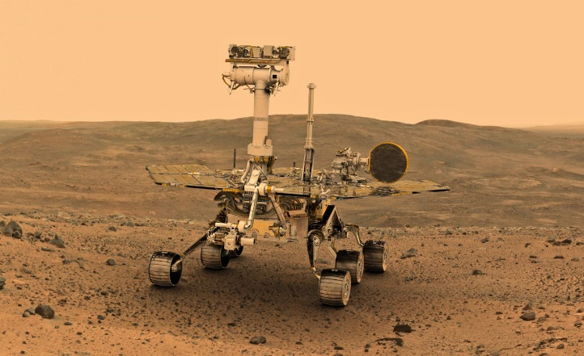
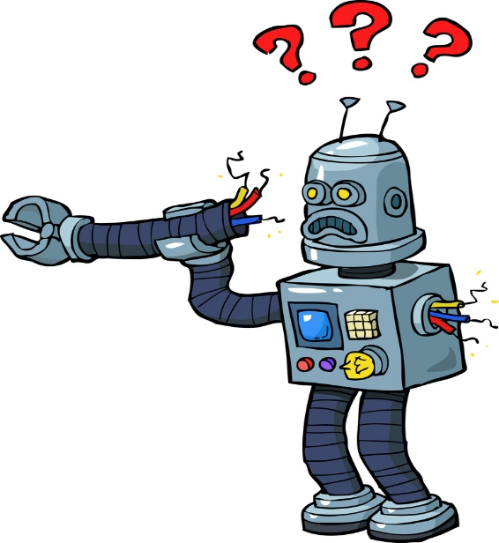
Problem Definition
Some places are inaccessible by humans (i.e. a completely unknown environment to work in).
Remotely controlled robot may have motor malfunction, stalling the work of robot.
“Build a Self Learning Robot which could self learn motion command without human intervention.”

Slide 6
Solution Strategy
Use of Reinforcement Learning.
Have reward function using feedback from the environment.
Use Python to implement the concept of Q-Learning.
Robot controlled from a remote.

Slide 7
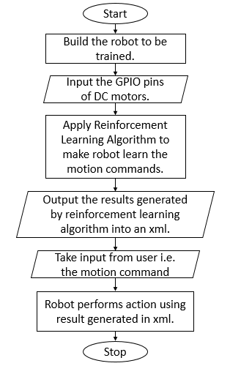

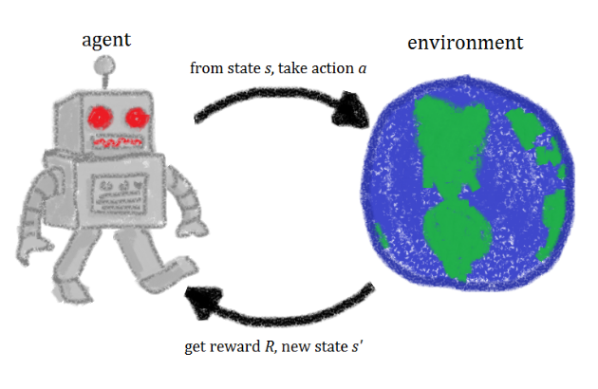
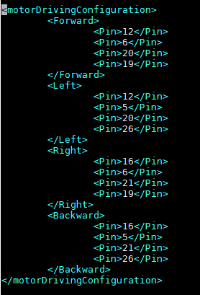
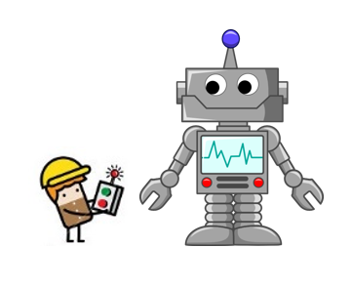
Flow Chart (Overview)
Fig 2: Flow chart of overall procedure

Slide 8
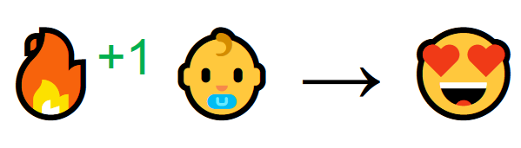
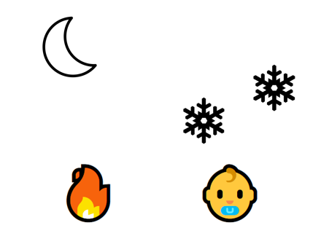

Reinforcement Learning
Fig 3: Reinforcement Learning Example

Slide 9
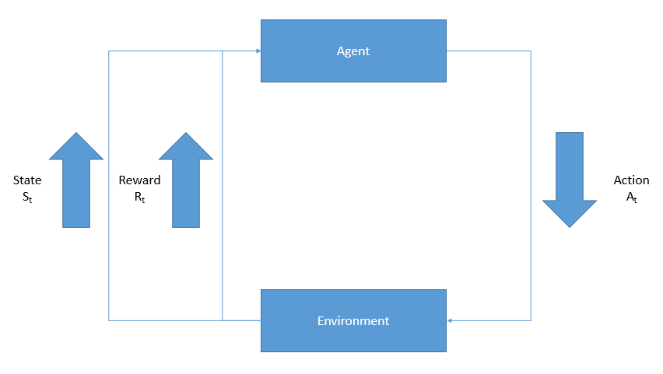
Q-Learning (Reinforcement Learning)
Agent interacts with the environment.
A good action fetches positive reward and a bad action fetches negative reward.
Episodic task.
Model-Free Value based approach.
Uses the concept of temporal difference learning.
Fig 4: Block Diagram of Q-Learning

Slide 10
Implementation
Considered 4 motor robot. (i.e. 5040 possible motions)
Use of Raspberry pi 3 as a processing unit to implement Reinforcement Learning.
Use of Motor driving IC(L293D) to control motors using raspberry pi.
Use of Gyro sensor and Accelerometer as a feedback.
Use of webpage to control the robot.

Slide 11
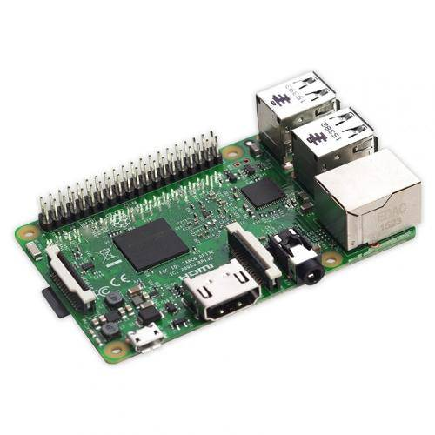
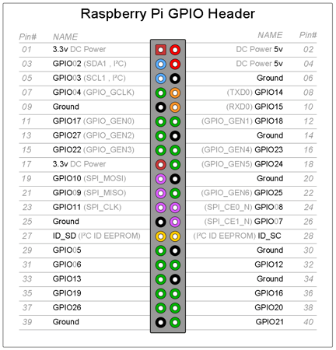
Hardware Description and Interfacing
Raspberry Pi 3 Model B+
Cortex A53 64-bit quad core
microprocessor.
40 GPIO pins.
Raspbian Operating System.
Fig 5: Raspberry Pi GPIO pins description
Fig 6: Raspberry Pi 3 Model B+

Slide 12
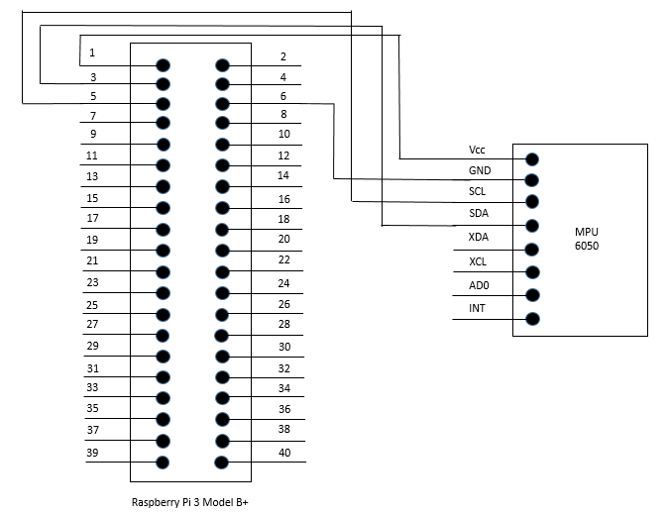
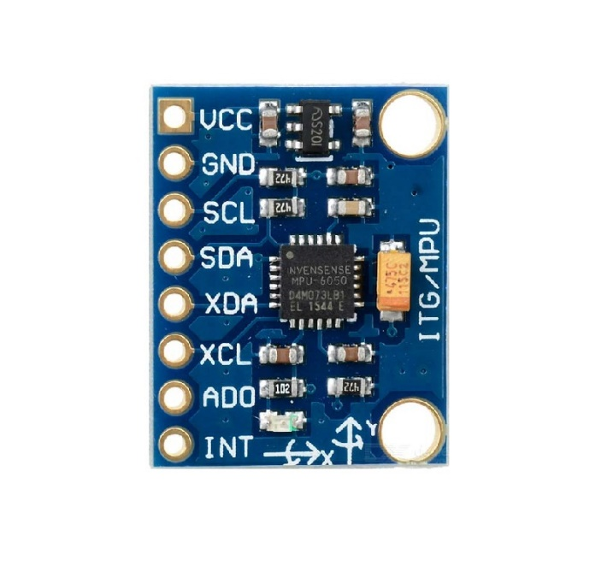
Hardware Description and Interfacing
MPU 6050
(Gyro sensor and Accelerometer)
Fig 8: Schematic Diagram
of Interfacing Raspberry Pi
and MPU 6050 Sensor
Fig 7: MPU 6050 Sensor

Slide 13
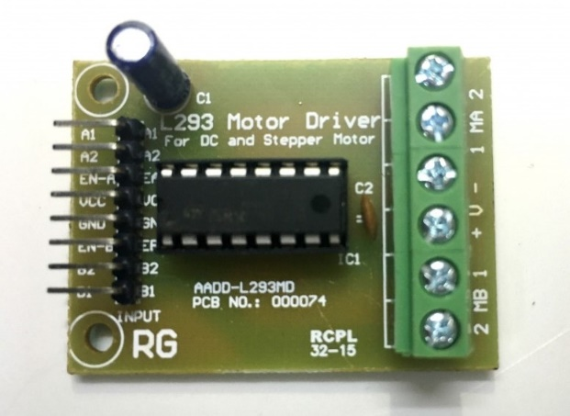
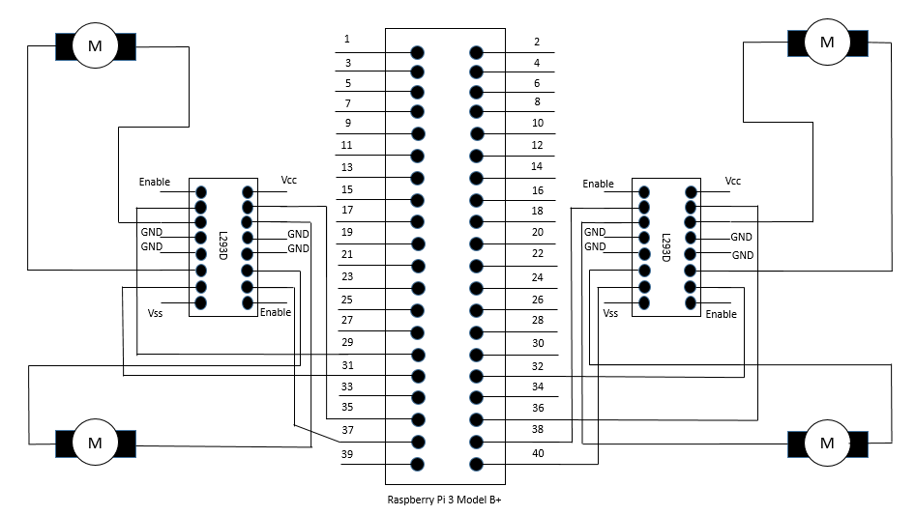
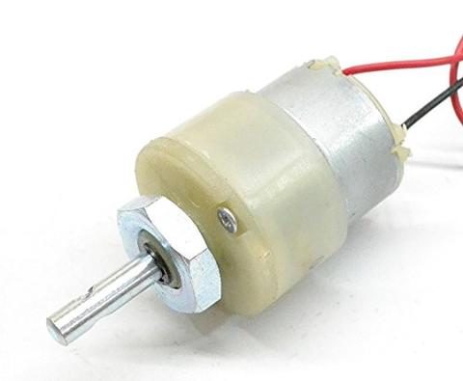
Hardware Description and Interfacing
Fig 9: L293D Motor Driving IC
Fig 10: DC Motor
Fig 11: Schematic Diagram of interfacing Raspberry Pi 3 with L293D and DC Motors

Slide 14
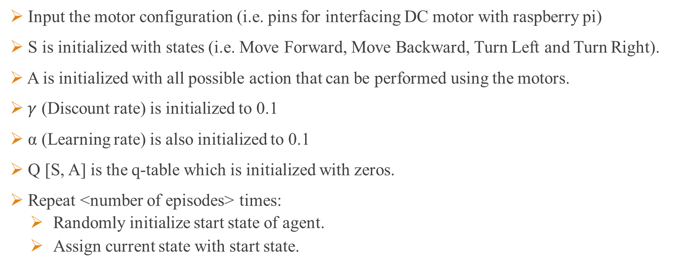
Steps followed:-
Input the motor configuration (i.e. pins for interfacing DC motor with raspberry pi)
S is initialized with states (i.e. Move Forward, Move Backward, Turn Left and Turn Right).
A is initialized with all possible action that can be performed using the motors.
$γ$ (Discount rate) is initialized to 0.1
α (Learning rate) is also initialized to 0.1
Q [S, A] is the q-table which is initialized with zeros.
Repeat <number of episodes> times:
Randomly initialize start state of agent.
Assign current state with start state.

Slide 15
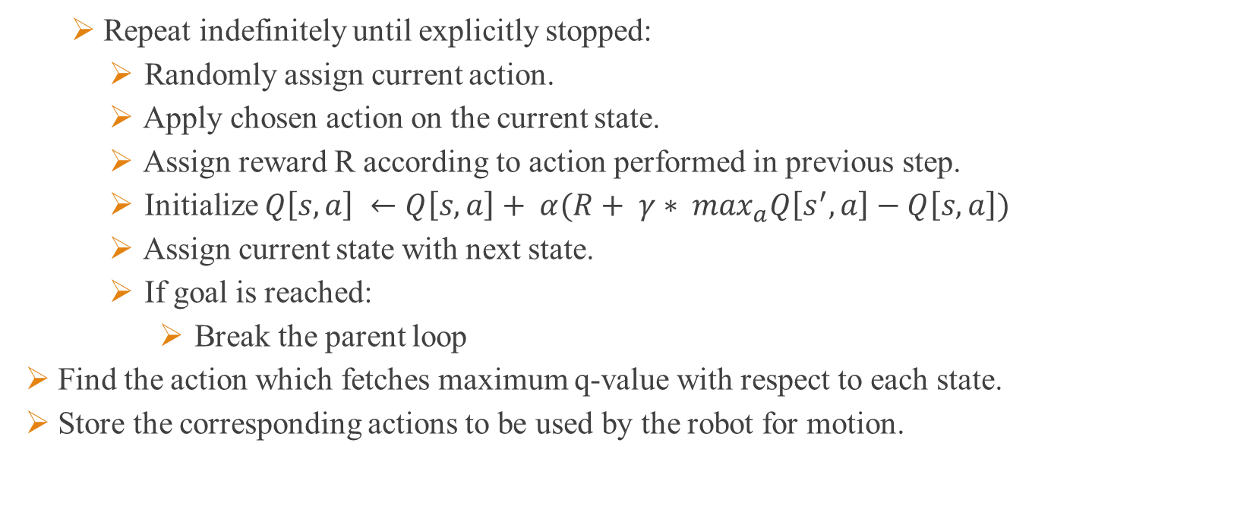
Steps followed:- Continued…
Repeat indefinitely until explicitly stopped:
Randomly assign current action.
Apply chosen action on the current state.
Assign reward R according to action performed in previous step.
Initialize $Q\left[s,a\right] ←Q\left[s,a\right]+ α(R+ γ∗ \max_{a}Q\left[s^{′}, a\right]−Q\left[s,a\right])$
Assign current state with next state.
If goal is reached:
Break the parent loop
Find the action which fetches maximum q-value with respect to each state.
Store the corresponding actions to be used by the robot for motion.

Slide 16

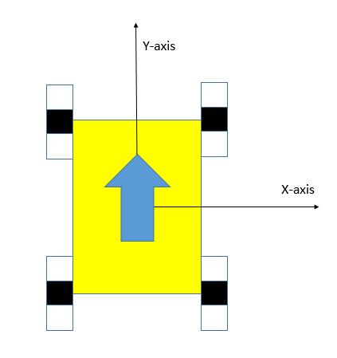
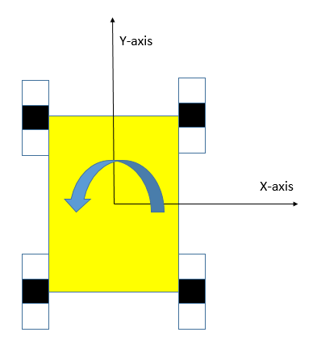
Reward Function:-
If Instruction Is Move Forward
If Instruction Is Turn Left
+ 25
+ 25
Fig 12: Learning Forward Motion
Fig 13: Learning Left Turn

Slide 17
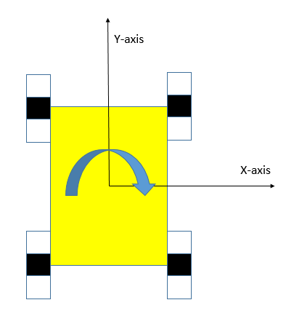
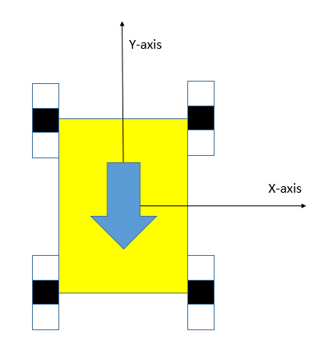
Reward Function:- Continued…
If Instruction Is Turn Right
If Instruction Is Move Backward
+ 25
+ 25
Fig 14: Learning Right Turn
Fig 15: Learning Backward Motion

Slide 18

Reward Function:- Continued…
Else:
Reward = - 25
Fig 16: Incorrect Action

Slide 19
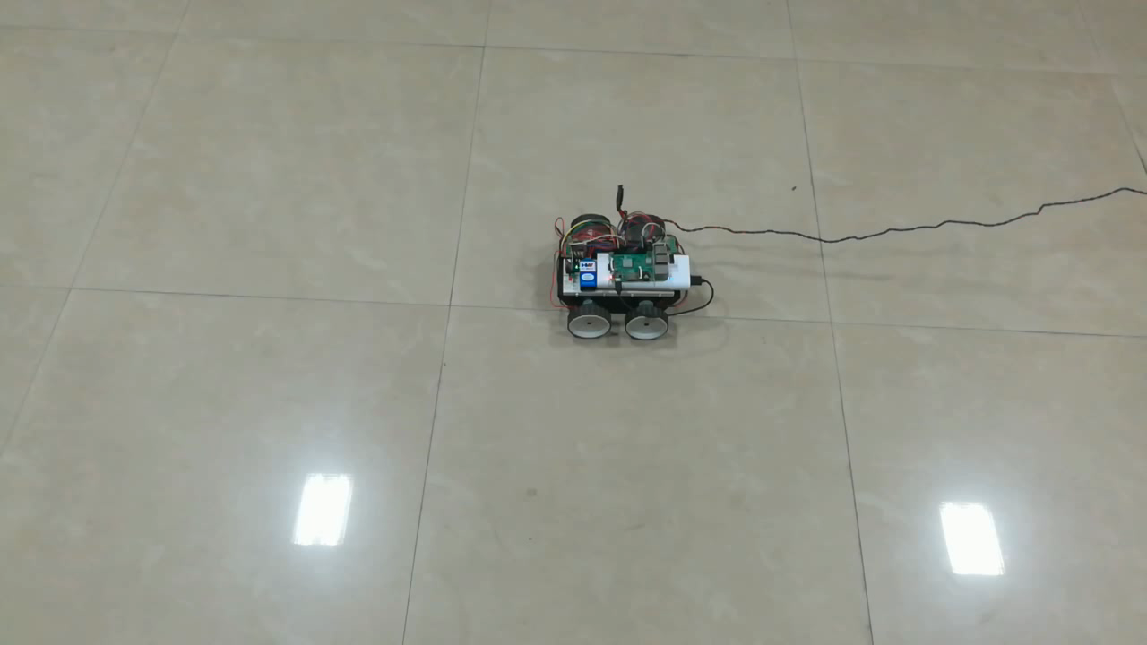
Training Forward Movement
Video 1: Training
Forward Motion
of the Robot

Slide 20
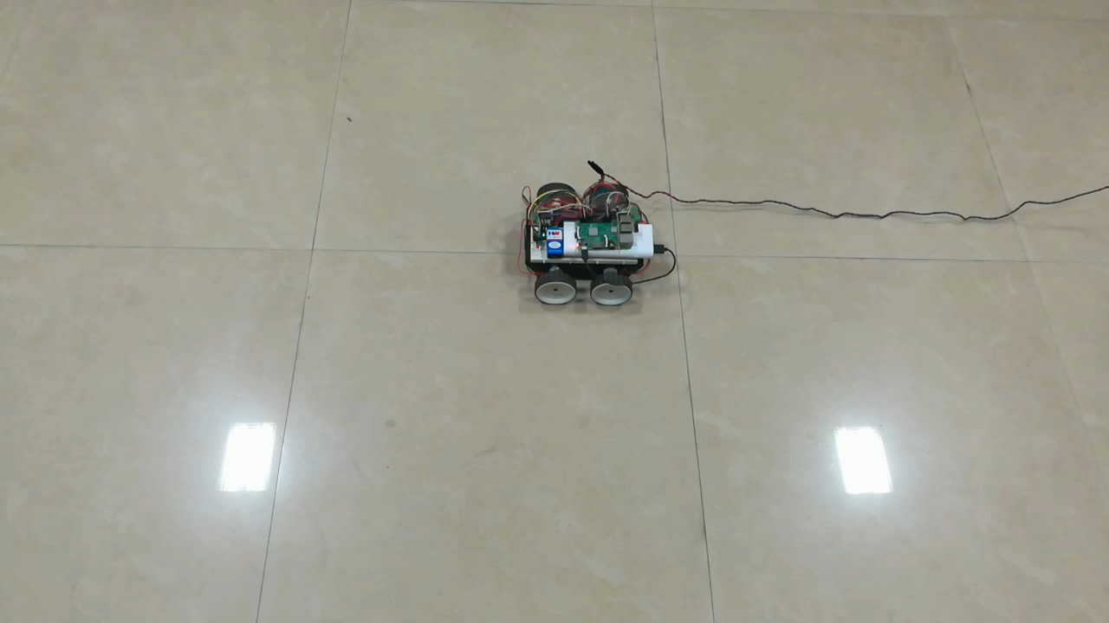
Training Left Turn
Video 2: Training
Left Turn of the
Robot

Slide 21
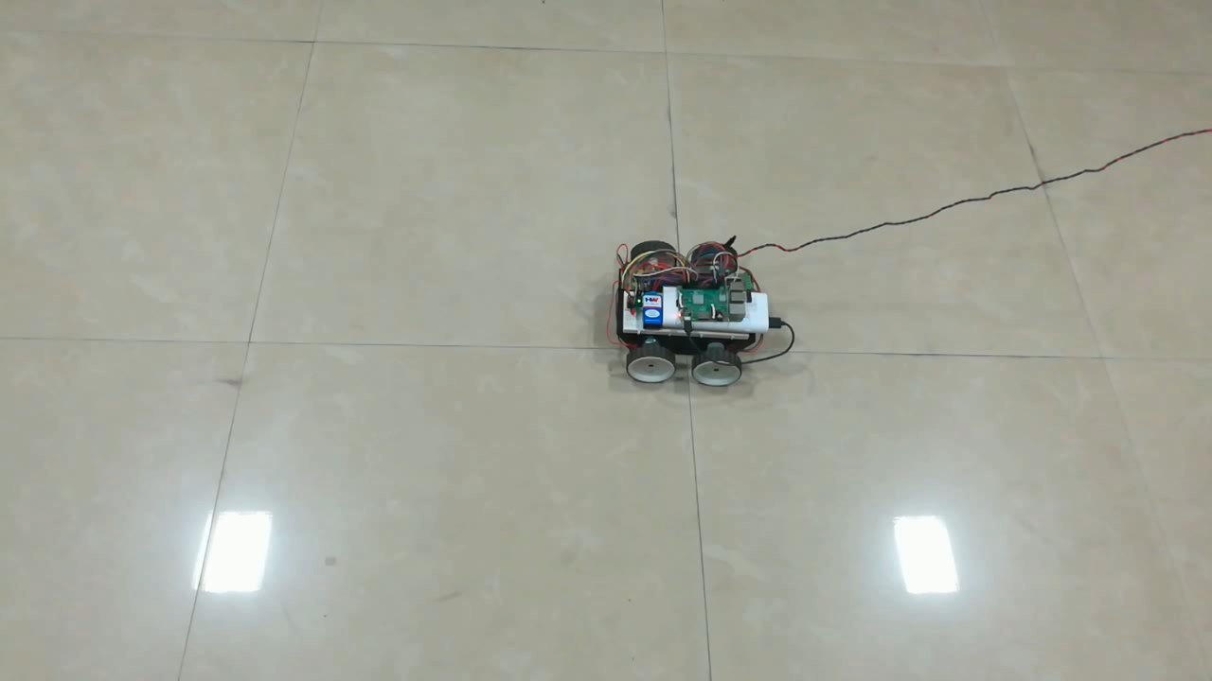
Training Right Turn
Video 3: Training
Right Turn of the
Robot

Slide 22
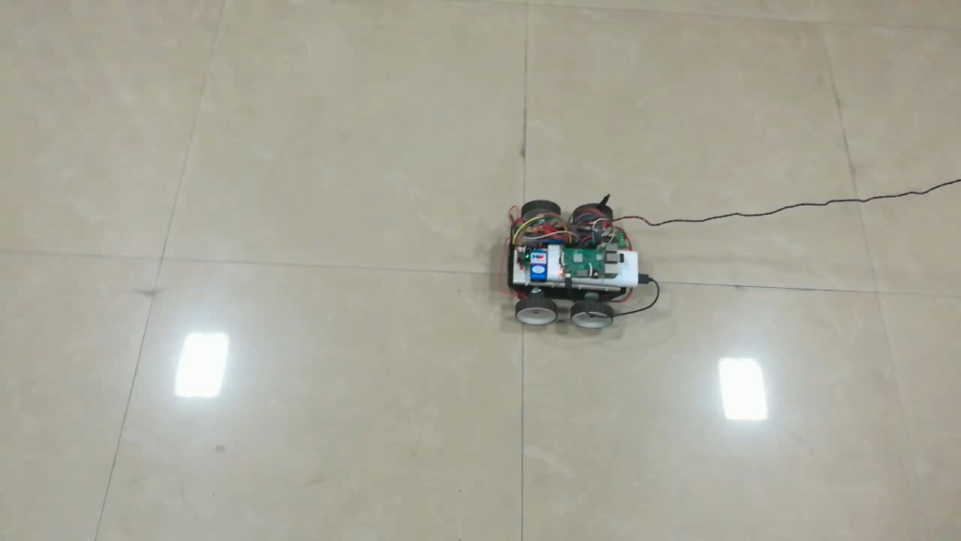
Training Backward Movement
Video 4: Training
Backward Motion
of the Robot

Slide 23
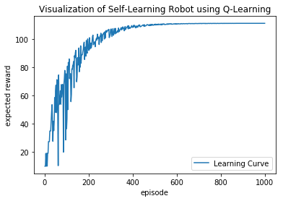
Visualization of Learning Process
Fig 17: Visualization of Q-Learning Process of Self-Learning Robot

Slide 24
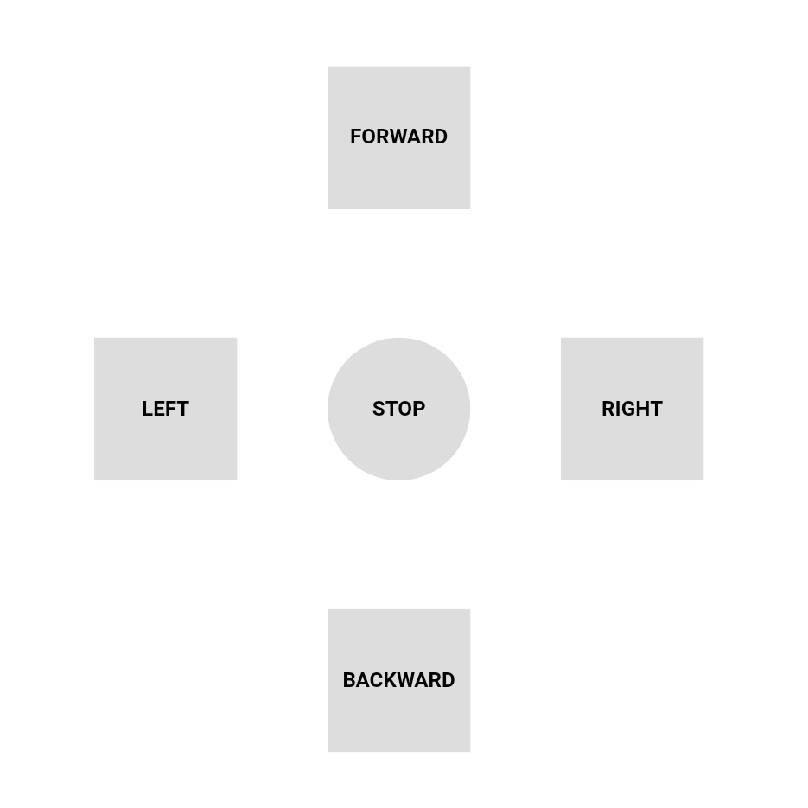
Output
Fig 18: XML output of Q-Learning Process
Fig 19: Webpage based remote to control robot

Slide 25
Conclusion
Was able to build a robot which could self teach to learn motion commands.
Was able to make robot self recoverable from any malfunction in locomotive parts of robot.
Was able to learn motion command even in new environment.
Control robot using a remote after being trained.

Slide 26
References
[1] Sutton, Richard S., and Andrew G. Barto. Reinforcement learning: An introduction. Vol. 1. No. 1. Cambridge: MIT press, 1998.
[2] Sutton, Richard S. "Learning to predict by the methods of temporal differences." Machine learning 3.1 (1988): 9-44.
[3] Berná-Martínez, José Vicente, and Francisco Maciá Pérez. "Robotic control systems based on bioinspired multi-agent systems: application of the principles of neuroscience to robotics." (2011).
[4] Dayan, Peter, and Geoffrey E. Hinton. "Feudal reinforcement learning." Advances in neural information processing systems. 1993.
[5] Littman, Michael L. "Friend-or-foe Q-learning in general-sum games." ICML. Vol. 1. 2001.

Slide 27
Thank You.

